Slide 1
Treasurer’s report to the
24 October 2024

Slide 2
2023 Audited Accounts
2024 Results for nine months
2025 Budget for year and proposed quota

Slide 3
2023 Audited Accounts
General Fund surplus £15k (2.5% of income)
Project Funds surplus £7k (11% of income)
Restricted Funds surplus £23k
Investment gains £698k (15%)

Slide 4
UTP price compared to FTSE in 2023

Slide 7
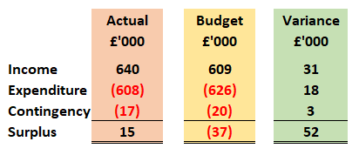
General Fund compared to budget

Slide 8
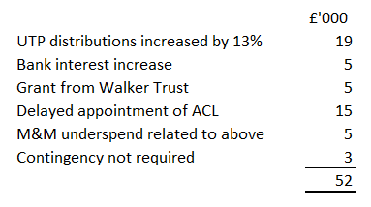
Reasons for variance

Slide 9
General Fund budget 2024
Expenditure 9% up on 2023 budget
Provincial quota up 6%
Inflationary increases averaging 6%
Additional £25,000 spend on net zero works at Bishop’s house
Quota increase restricted to 3%
Assumes UTP distributions at same level as 2023
Results in a deficit of £62,000, funded by previous surpluses

Slide 12
Diocese General Fund : year to date
Income £12k over budget for nine months
Investment income £5k over budget
Walker Trust grant £5k unbudgeted
Costs running at 75% of annual budget
No special costs to be met from contingencies
Nine-month deficit £14k
Projected deficit for year c. £34k
Compared with budgeted deficit of £42k

Slide 13
General Fund budget 2025
Expenditure 1.5% up on 2024 projected outturn
Provincial quota up 7.6%
Inflationary increases averaging 3%
Change in Pension Contributions reduces staff costs
Assumes UTP distribution of 90ppu (87p in 2024; 85p in 2023)
Other income likely to be same overall as in 2024
Want to return to break-even budgeting
Proposed quota increase of 8% in total

Slide 14
Comparing Provincial and Diocesan Quota

Slide 15
Elements of Diocesan Quota

Slide 16
Quota – in summary….
Recurring expenditure should be funded from recurring income rather than by realising investments
We held back quota increases during the post-pandemic years of high inflation, utilising surpluses made when staff levels were low.
With a pensions windfall, this is the year when a return to normal quota levels can best be afforded by most Charges.
Even with an 8% increase in 2024, quota will still only be 4.7% higher than in 2020
Funds are available for Charges unable to afford the increase.

Slide 17
Activities not funded by quota
Investing in the Future Projects
Total commitment is £750,000 over five years
7 Charges being supported with grants now totalling £11,236 per month
Other projects being considered
Registration of Controlled Interests in Property
Grants for congregational mission and buildings projects
Green grants

Slide 18
Treasurer’s report to the
Any questions?

